Slide 1
Welcome to Curriculum Night
2023-2024 School Year

Slide 2
Homework Policy
No homework will be given to students prior to vacations.
Assignment will be given upon the student return.
Absent 5 days = work due 5 days after return
Tests must be taken within one week of the original test date.

Slide 3
Reading in Grades 3-5
In Kindergarten through second grade, students are learning to read.
In third through fifth grades, students are reading to learn.
Reading and writing become a crucial part of everything we do, including math.
Everyone should be reading for at least 20 minutes per evening.

Slide 4
Expectations for Student Work
Complete sentences to answer questions. (default setting)
Spell words correctly when copied from book or page itself.
Proper capitalization and punctuation
Show work in math

Slide 5
Study Habits
Curriculum spirals-each year builds on the previous years’ learning.
Math corrections - do not erase - instead redo the problem and highlight the answer
Prepare for tests earlier than just night before.

Slide 6
Organizational Help
Student Binder: labeled with subjects for easy reference.
Reference materials in binder for quick locating of papers.
Please do not take papers out of the binder!

Slide 7
Classroom Technology
What is Google Classroom? a web-based platform that enables teachers to create an online classroom area to manage documents and more!
Sadlier Vocabulary: Introduced in 3rd grade, becomes a graded subject in 4th/5th (on Chromebook).
Xtra Math: Program that teaches basic facts. Students progress through levels. (3rd, 4th, and 5th grade)
Accelerated Reader: Coming soon!

Slide 8
Fast Direct
Check Fast Direct for teacher bulletin boards and calendars.
Tests posted on teacher’s calendar.
Bulletin boards have links for classroom sites and classroom information.
Contact teachers via Fast Direct. (Please give a business day for a response. Evening emails may not get answered until the next day.)
Handbook: Dress code policy (sock colors, skirt/shorts lengths, etc.); tardies

Slide 9
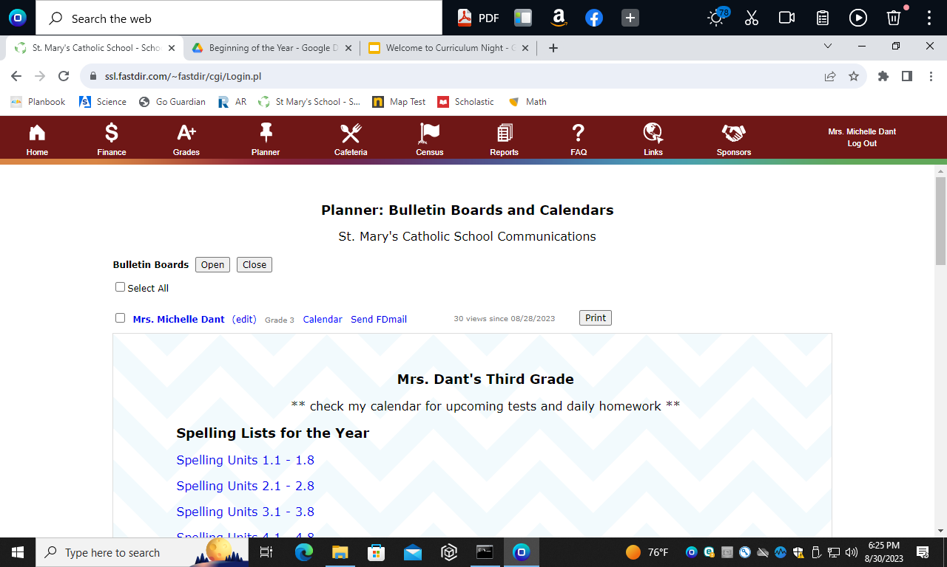

Slide 10
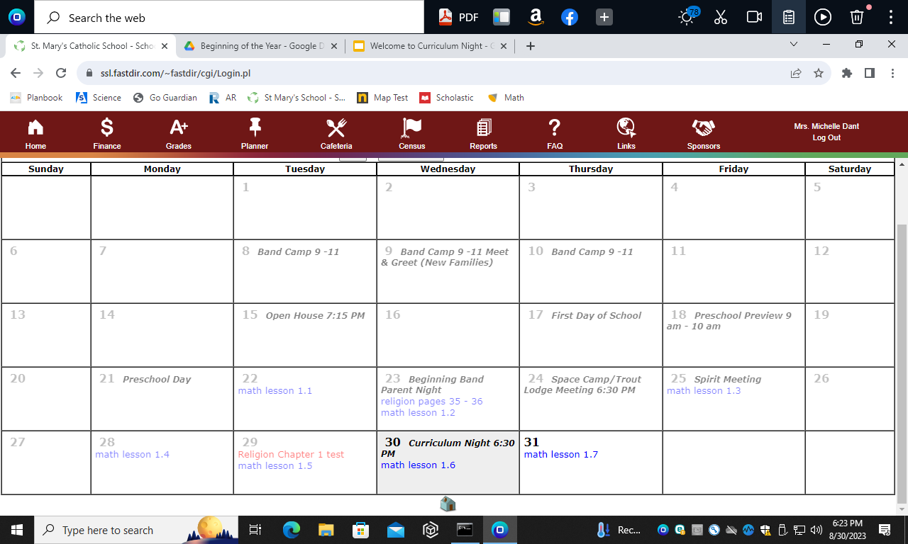

Slide 11
Thank you for coming!
Feel free to contact us on Fast Direct with any questions.

